Slide 1
Week 4
THE relational algebra Binary operation of Outer Joins (FULL, RIGHT AND LEFT)

Slide 2
Student Objectives
Upon completion of this video, you should be able to:
Identify the symbols for FULL, LEFT and RIGHT outer joins.
Write a relational algebra expression that uses OUTER JOINS given two tables based on a given query.
Given 2 tables and an OUTER JOIN relational algebra expression, show the new table that would be returned once the expression is performed.
Given an OUTER JOIN relational algebra expression and two tables, explain in simple English what query is answered by the expression.

Slide 3
FULL OUTER JOIN
A full outer join is similar to a join except that it includes all the rows from both tables even if they don’t have a matching value in the column that you are joining. If there is no match, put nulls in the columns from the other table.
Table2
Table1
B | F | G
Yellow | Cat | 22
Red | Cat | 33
Green | Dog | 44
Red | Dog | 24
Orange | Bird | 33
Table1 Table2 (outer natural join) Table1 columnnametable1=columnnametable2Table2 (outer equi join)
A | B | C | D
12 | Red | Can | 24
24 | Red | USA | 33
45 | Blue | Mex | 33
ANSWER FOR Table1 Table2
ANSWER FOR Table1 _{D=G} Table2
A | B | C | D | F | G
12 | Red | Can | 24 | Cat | 33
12 | Red | Can | 24 | Dog | 24
24 | Red | USA | 33 | Cat | 33
24 | Red | USA | 33 | Dog | 24
45 | Blue | Mex | 33 | Null | Null
Null | Yellow | Null | Null | Cat | 22
Null | Green | Null | Null | Dog | 44
Null | Orange | Null | Null | Bird | 33
A | Table1.B | C | D | Table2.B | F | G
12 | Red | Can | 24 | Red | Dog | 24
24 | Red | USA | 33 | Red | Cat | 33
24 | Red | USA | 33 | Orange | Bird | 33
45 | Blue | Mex | 33 | Red | Cat | 33
45 | Blue | Mex | 33 | Orange | Bird | 33
Null | Null | Null | Null | Yellow | Cat | 22
Null | Null | Null | Null | Green | Dog | 44

Slide 4
Full Outer Join: R S: a join in which tuples from R that do not have matching (equal) values in the common columns of S still appear and tuples in S that do not have matching values in the common columns of R still appear in the resulting relation (padding the fields with nulls)
Left Outer Join: R S : a join in which tuples from R that do not have matching values in the common columns of S still appear in the resulting relation
Right Outer Join: R S: tuples in S that do not have matching values in the common columns of R still appear in the resulting relation.

Slide 5
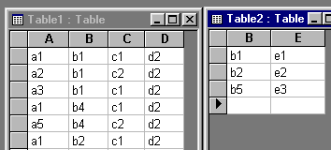
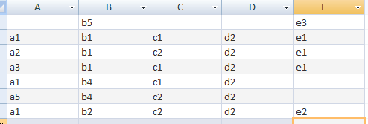
Example: Outer Join
QUESTION: What will the following expression result in?
Table1 Table2

Slide 6
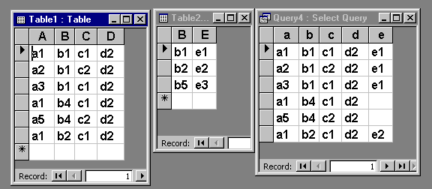
Example: Left Outer Join
Table 2
Table 1
Table1 Table2

Slide 7
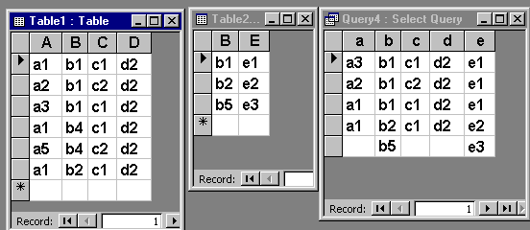
Example: Right Outer Join
Table1 Table2

Slide 8
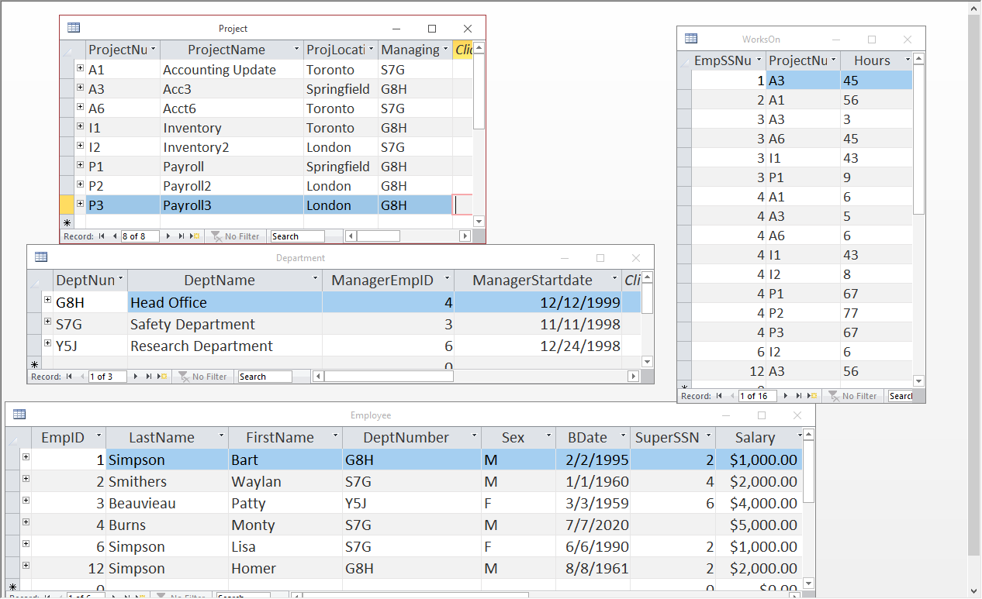
Might use an outer join for example in a situation like: Find the name of all employees and list the department name if they also manage a department.
QUESTION: Write the relational algebra for the above situation:
TEMP ← Department _{ManagerEmplD=EmpID}Employee
ANSWER← π _{FirstName,LastName,DeptName} (TEMP)

